Slide 1

Audio Signal Compression
Akademia Górniczo-Hutnicza im. Stanisława Staszica w Krakowie
AGH University of Science and Technology
Mikołaj Leszczuk

Slide 2


What is a bit rate of a typical consumer stereo audio stream, compressed with MP3 codec?
https://www.menti.com/ahd8rr5vie

Slide 3
Why Compression?
Uncompressed
Compressed
Uncompressed audio:
PCM telephony – 64 kbit/s
First media – 131-384 kbit/s
Radio and TV broadcasting – 512, 768 kbit/s
Consumer Hi-Fi: CD, DAT – 705.6, 768 kbit/s
High End and studio – 1920-4608 kbit/s
Compression is required!
Compressed audio (lossy) – 64 kbit/s
Achieved ratio – 1:200

Slide 4
Lossy Audio Compression (Coding) Steps
Change of representation (modelling)
Quantization (simplification of the model)
Binary encoding
Model parameters
A string of binary symbols
The original signal

Slide 5
Most Popular Lossy Audio Codecs
MPEG Audio Layer III (MP3)
Advanced Audio Coding (AAC)
Vorbis

Slide 6

MP3 – General Info
Initial release: 1993
Developed by Fraunhofer (IIS) & Thompson
Standardized by MPEG Audio Committee of ISO & IEC
Closed format – active patents in United States
This photo, author: Author unknown, license: CC BY-SA
Notes:
MP3 (formally MPEG-1 Audio Layer III or MPEG-2 Audio Layer III) is a coding format for digital audio developed largely by the Fraunhofer Society in Germany, with support from other digital scientists in the US and elsewhere. Originally defined as the third audio format of the MPEG-1 standard, it was retained and further extended — defining additional bit-rates and support for more audio channels — as the third audio format of the subsequent MPEG-2 standard. A third version, known as MPEG 2.5 — extended to better support lower bit rates — is commonly implemented, but is not a recognized standard.

Slide 7
MP3 Compression
Faithful CD audio reproduction at 128 kbit/s (1:11):
Higher bit rate => higher quality
Lower bit rate => lower quality
Perceptual coding – reducing certain parts of audio accuracy beyond auditory ability
Using psycho-acoustic models to:
Discard/reduce less audible components by Modified Discrete Cosine Transform (MDCT)
Record remaining information
Stereo or 5.1 audio
Supported sampling rates up to 48 kHz
Notes:
MP3 compression works by reducing (or approximating) the accuracy of certain components of sound that are considered (by psychoacoustic analysis) to be beyond the hearing capabilities of most humans. This method is commonly referred to as perceptual coding or as psychoacoustic modelling. The remaining audio information is then recorded in a space-efficient manner, using MDCT and FFT algorithms. Compared to CD-quality digital audio, MP3 compression can commonly achieve a 75 to 95% reduction in size. For example, an MP3 encoded at a constant bitrate of 128 kbit/s would result in a file approximately 9% of the size of the original CD audio.

Slide 8
MP3 Market Adoption
Amazon
Rhapsody
Radionomy

Slide 9
AAC – General Info
Initial release: 1997
Developed by Bell Labs, Fraunhofer (IIS), Dolby Labs, Sony & Nokia
Standardized by ISO & IEC
Part of specifications of MPEG-2 & MPEG-4
Closed format – codec license required
Notes:
Advanced Audio Coding (AAC) is an audio coding standard for lossy digital audio compression. AAC has been standardized by ISO and IEC as part of the MPEG-2 and MPEG-4 specifications.

Slide 10
AAC Compression
Designed to be successor of MP3
Better quality at similar bit-rates
Featuring
Up to 48 audio channels with frequency range up to 96 kHz
Up to 16 LF effect channels with frequency range up to 120 Hz
Notes:
Designed to be the successor of the MP3 format, AAC generally achieves higher sound quality than MP3 at the same bit rate. AAC supports inclusion of 48 full-bandwidth (up to 96 kHz) audio channels in one stream plus 16 low frequency effects (LFE, limited to 120 Hz) channels, up to 16 "coupling" or dialog channels, and up to 16 data streams. The quality for stereo is satisfactory to modest requirements at 96 kbit/s in joint stereo mode; however, hi-fi transparency demands data rates of at least 128 kbit/s (VBR). Tests of MPEG-4 audio have shown that AAC meets the requirements referred to as "transparent" for the ITU at 128 kbit/s for stereo, and 320 kbit/s for 5.1 audio.

Slide 11
AAC Market Adoption
Apple
Google
Netflix
Nintendo
Sony
BlackBerry

Slide 12
Vorbis – General Info
Initial release: 2000
Developed by Xiph.Org Foundation
Standardised by specification
Open format – lack of patent restrictions
This photo, author: Author unknown, license: CC BY-SA
Notes:
Vorbis is a free and open-source software project headed by the Xiph.Org Foundation. The project produces an audio coding format and software reference encoder/decoder (codec) for lossy audio compression. Vorbis is most commonly used in conjunction with the Ogg container format and it is therefore often referred to as Ogg Vorbis.

Slide 13
Vorbis Compression (1/2)
Algorithm also based on MDCT but minimally:
Smaller files, or
Higher quality
Features:
Up to 255 channels
16-bit sound
Frequency range up to 48 kHz
Notes:
Listening tests showed Vorbis performed significantly better than many other lossy audio formats in that it produced smaller files at equivalent or higher quality while retaining computational complexity comparable to other MDCT formats such as AAC and Windows Media Audio. Vorbis is intended for sample rates from 8 kHz telephony to 192 kHz digital masters and a range of channel representations (monaural, polyphonic, stereo, quadraphonic, 5.1, ambisonic, or up to 255 discrete channels).

Slide 14
Vorbis Compression (2/2)
Breakdown of stream on windows in 2 sizes:
Large (usually 2048 samples)
Small (typically 256 samples)
Performing MDCT in each window
Simplifying data from MDCT (psycho-acoustic model)
Scaling of data depending on energy
Quantification and lossless data compression
Notes:
Vorbis is a forward-adaptive monolithic transform codec based on the modified discrete cosine transform (MDCT). Vorbis uses the modified discrete cosine transform for converting sound data from the time domain to the frequency domain. The resulting frequency-domain data is broken into noise floor and residue components, and then quantized and entropy coded using a codebook-based vector quantization algorithm. The decompression algorithm reverses these stages. he noise-floor approach gives Vorbis its characteristic analog noise-like failure mode when the bitrate is too low to encode the audio without perceptible loss.

Slide 15
Vorbis Market Adoption
Wikipedia
OSS
Spotify
Samsung
SanDisk

Slide 16
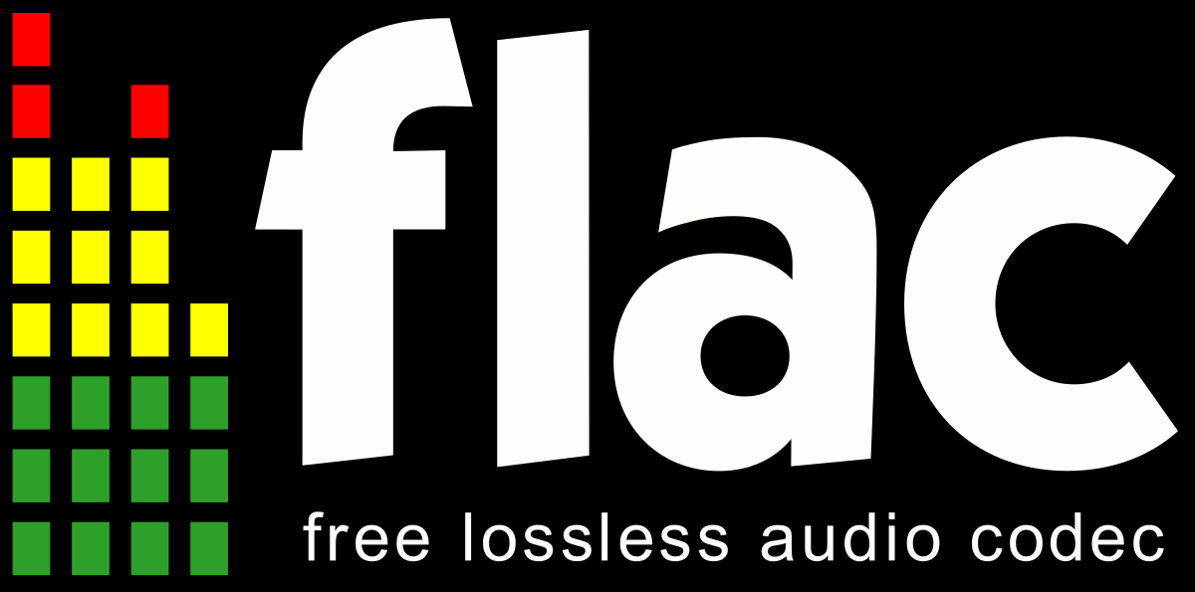
FLAC
Free Lossless Audio Codec; /flæk/
Audio coding format
Lossless compression
Developed by the Xiph.Org
Audio reduced to 50- 70% of its original size
This photo, author: Author unknown, license: CC BY-SA
Notes:
Contrary to lossy audio codecs such as Vorbis, MP3 and AAC, the FLAC (Free Lossless Audio Codec) codec does not remove any data from the audio stream, thanks to which, after decompression, we get a digital sound image identical to the original. FLAC is developed by the Xiph.Org Foundation, and is also the name of the free software project producing the FLAC tools, the reference software package that includes a codec implementation. Digital audio compressed by FLAC's algorithm can typically be reduced to between 50 and 70 percent of its original size and decompress to an identical copy of the original audio data.

Slide 17
Other Audio Codecs
ATRAC (created and patented by Sony Corp., used for PlayStation)
AC-3 (created and patented by Dolby Laboratories, used for DVD players and digital television)
MP2 – MPEG-1, 2 Audio Layer II (MP3 predecessor)
RealAudio (used for live broadcasting)
WMA – Windows Media Audio (created and patented by Microsoft)

Slide 18
Speech Codecs
SILK (created and patented by Skype Limited, free, used in Skype for voice recording)
G.711 (standardised by ITU-T, free, used in many VoIP software)
G.726 (standardised by ITU-T, free, used in some VoIP software)
AMR (created and patented by 3GPP, used by mobile network operators)
Speex (popular for open-source applications because of lack of patent restrictions)
Siren 7 (created and patented by Polycom Inc., used by Microsoft Lync)

Slide 19
A typical consumer stereo audio stream, compressed with MP3 codec, has bit rate of around...
https://www.mentimeter.com/s/ffecf2fbe62b6f9d8b494f4bdbd97c7e/132c6912b228

